Slide 1
Only One Out of Five Archived Web Pages Existed as Presented
Scott G. Ainsworth, Michael L. Nelson, Herbert Van de Sompel
(Proceedings of Hypertext 2015)
CS895 - Web Archiving Forensics, Fall 2020
Old Dominion University
Department of Computer Science
Kritika Garg, kgarg001@odu.edu

Slide 2
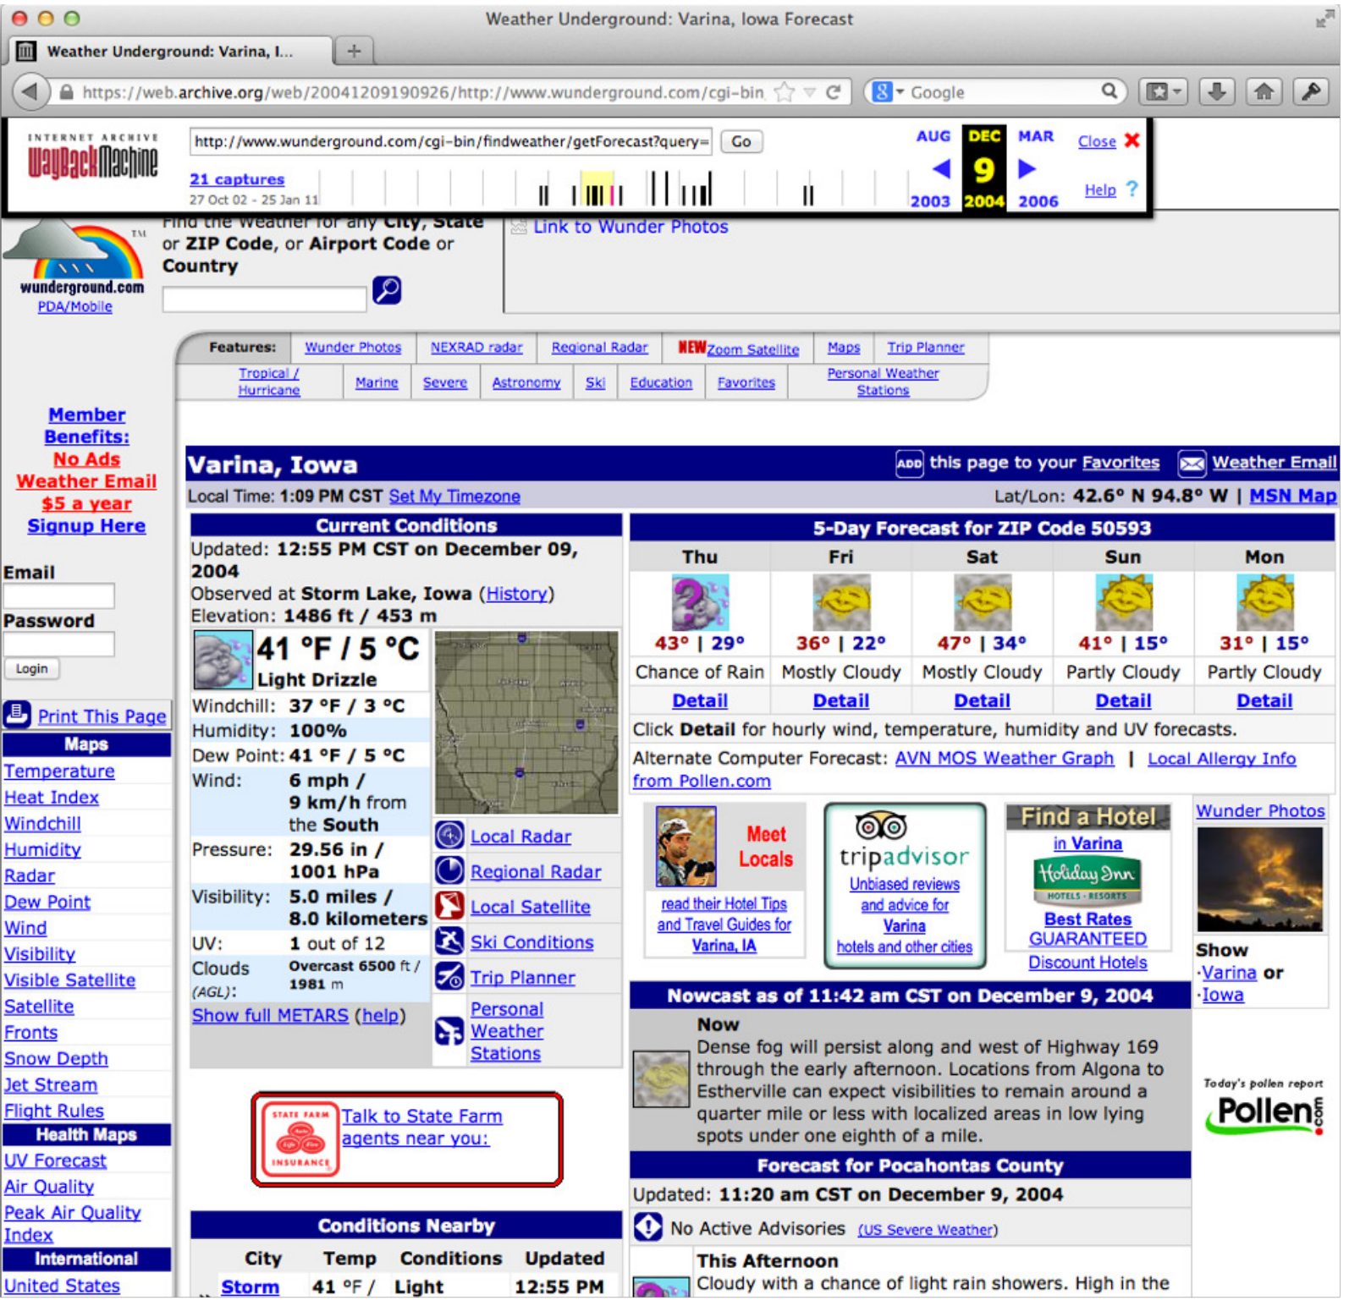
Figure 1: Wunderground Composite Memento, MementoDatetime 2004-12-09 19:09:26
https://citeseerx.ist.psu.edu/viewdoc/download?doi=10.1.1.711.77&rep=rep1&type=pdf

Slide 3
Figure 1: Wunderground Composite Memento, MementoDatetime 2004-12-09 19:09:26
https://citeseerx.ist.psu.edu/viewdoc/download?doi=10.1.1.711.77&rep=rep1&type=pdf

Slide 4
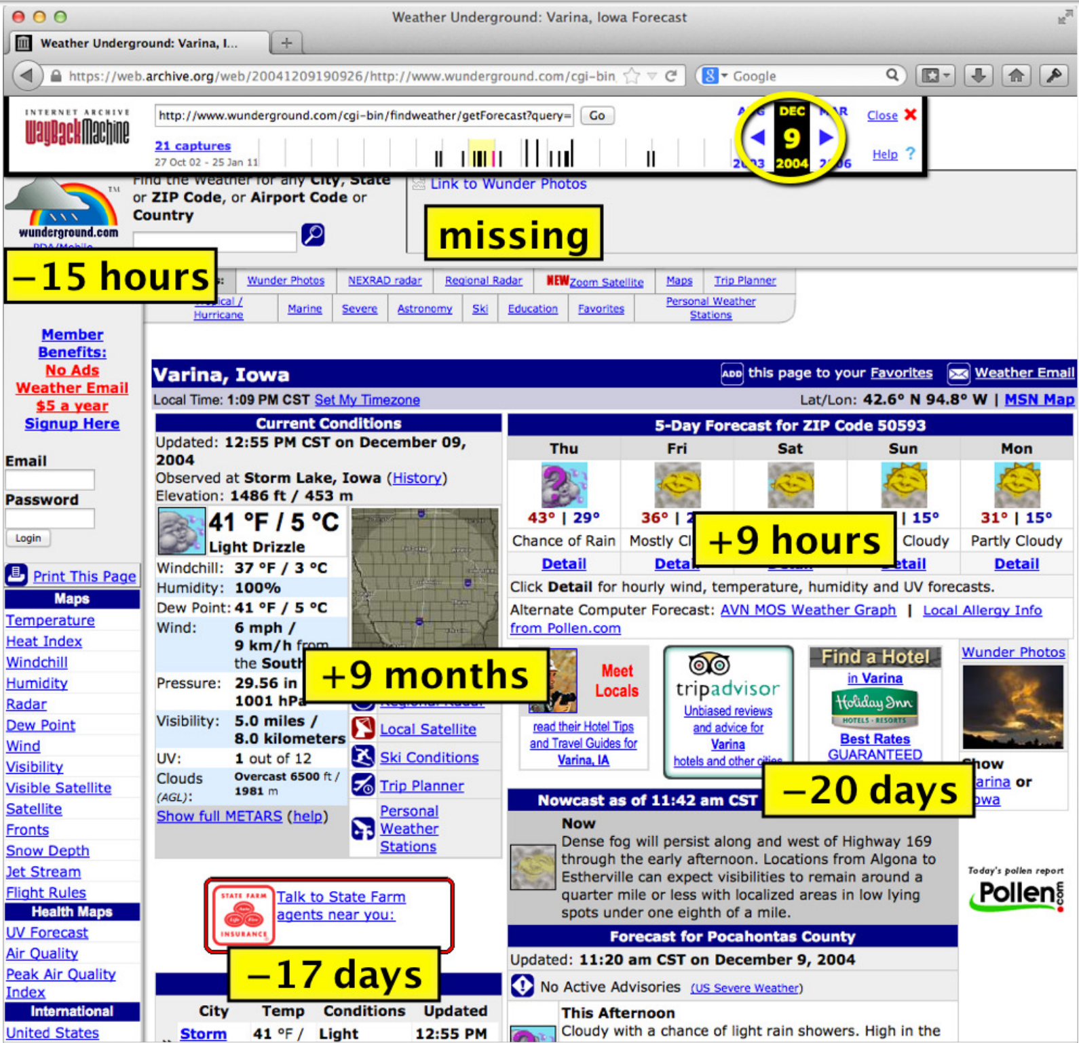
Figure 2: Wunderground Composite Memento, MementoDatetime 2004-12-09 19:09:26
https://citeseerx.ist.psu.edu/viewdoc/download?doi=10.1.1.711.77&rep=rep1&type=pdf

Slide 5
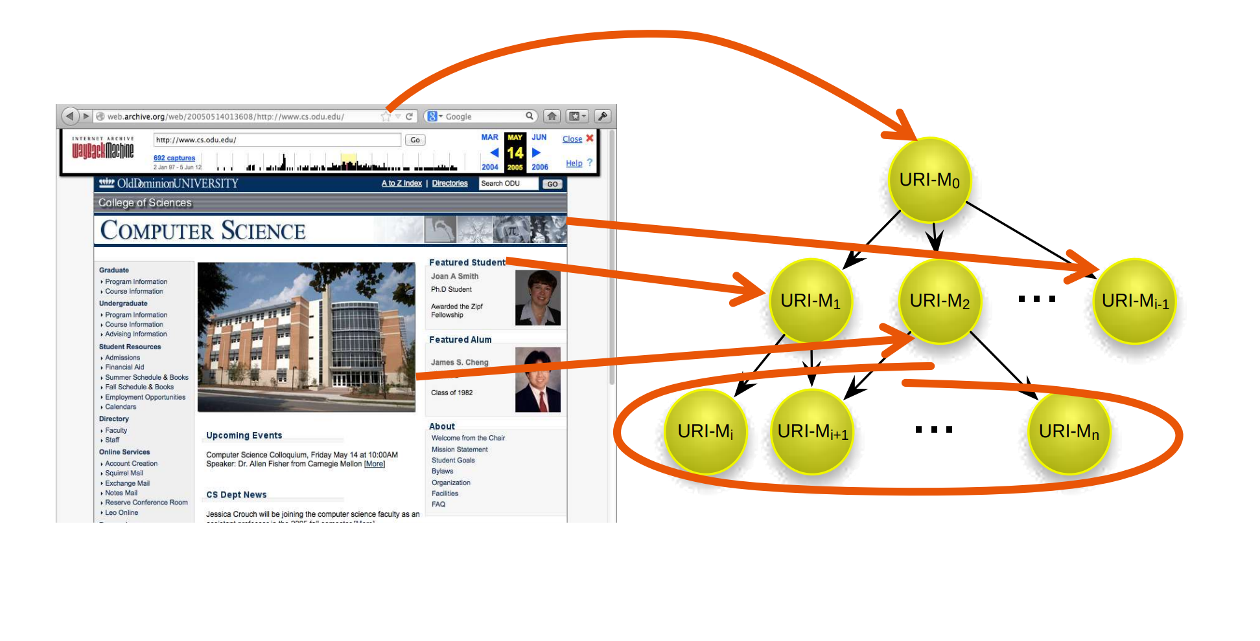
Composite Memento
https://ws-dl.blogspot.com/2015/12/2015-12-08-evaluating-temporal.html

Slide 6
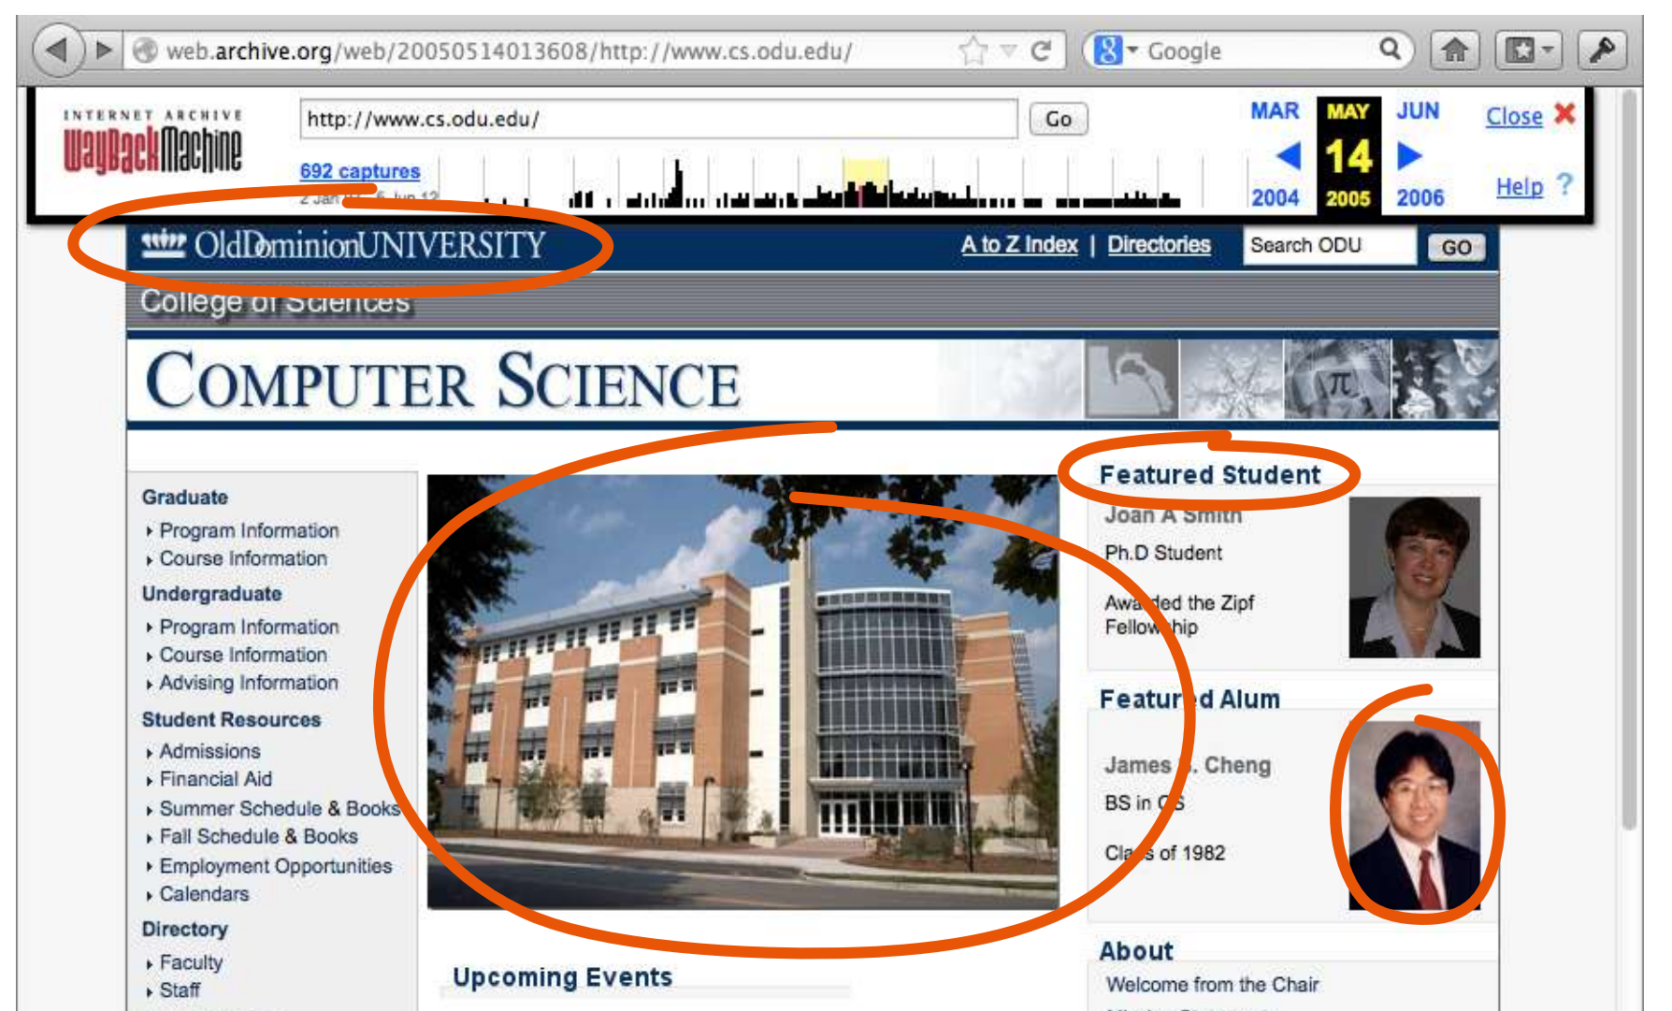
Temporal Coherence
Slide 20, https://www.slideshare.net/ScottAinsworth/only-one-out-of-five-archived-web-pages-existed-as-presented

Slide 7
Temporal Coherence
+9 days
+7 months
+18 days
+18 days
Slide 20, https://www.slideshare.net/ScottAinsworth/only-one-out-of-five-archived-web-pages-existed-as-presented

Slide 8
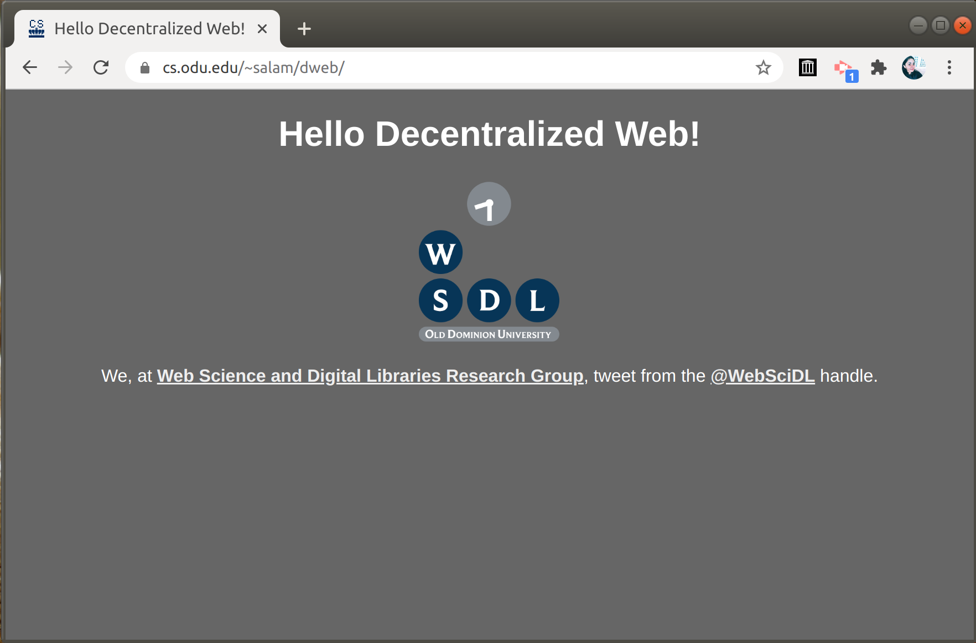
Completeness

Slide 9
Figure 2: Wunderground Composite Memento, MementoDatetime 2004-12-09 19:09:26
https://citeseerx.ist.psu.edu/viewdoc/download?doi=10.1.1.711.77&rep=rep1&type=pdf

Slide 10
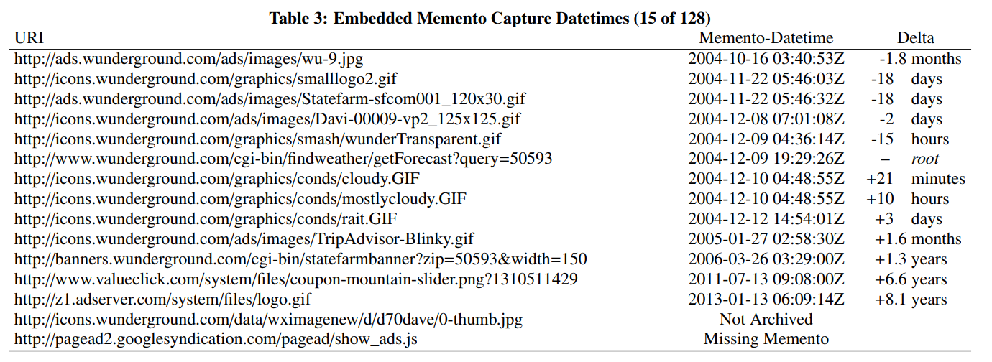
Temporal Spread = 8.3 years
Mean delta = 1.8 years
standard deviation = 2.9 years
https://arxiv.org/pdf/1402.0928.pdf

Slide 11
Embedded resource captured within the seconds of root, may still not be temporally coherent
Embedded resource captured much after than root, may not be incoherent.

Slide 12
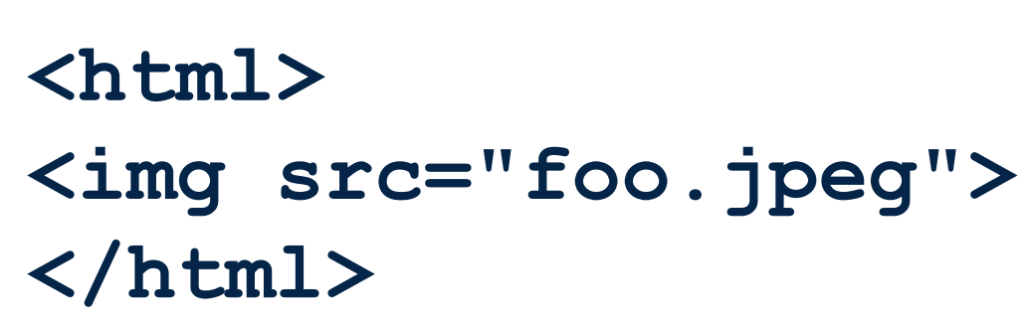
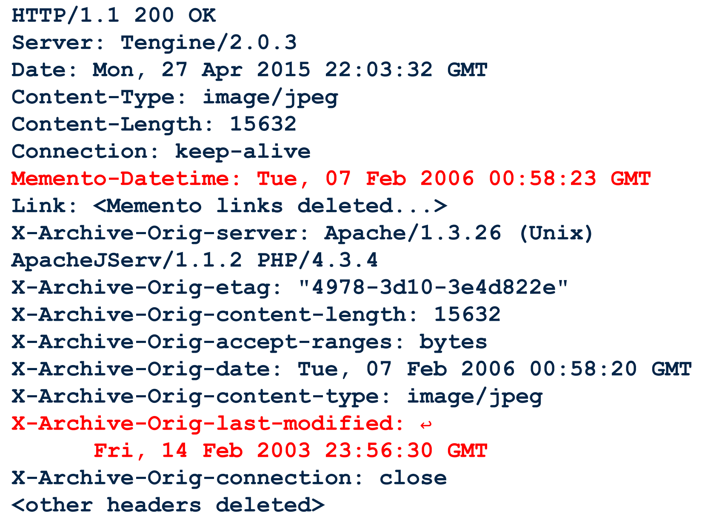
Slide 11,12, https://www.slideshare.net/ScottAinsworth/only-one-out-of-five-archived-web-pages-existed-as-presented

Slide 13
Temporal Coherence States
Prima Facie Coherent
Possibly Coherent
Probably Violative
Prima Facie Violative

Slide 14
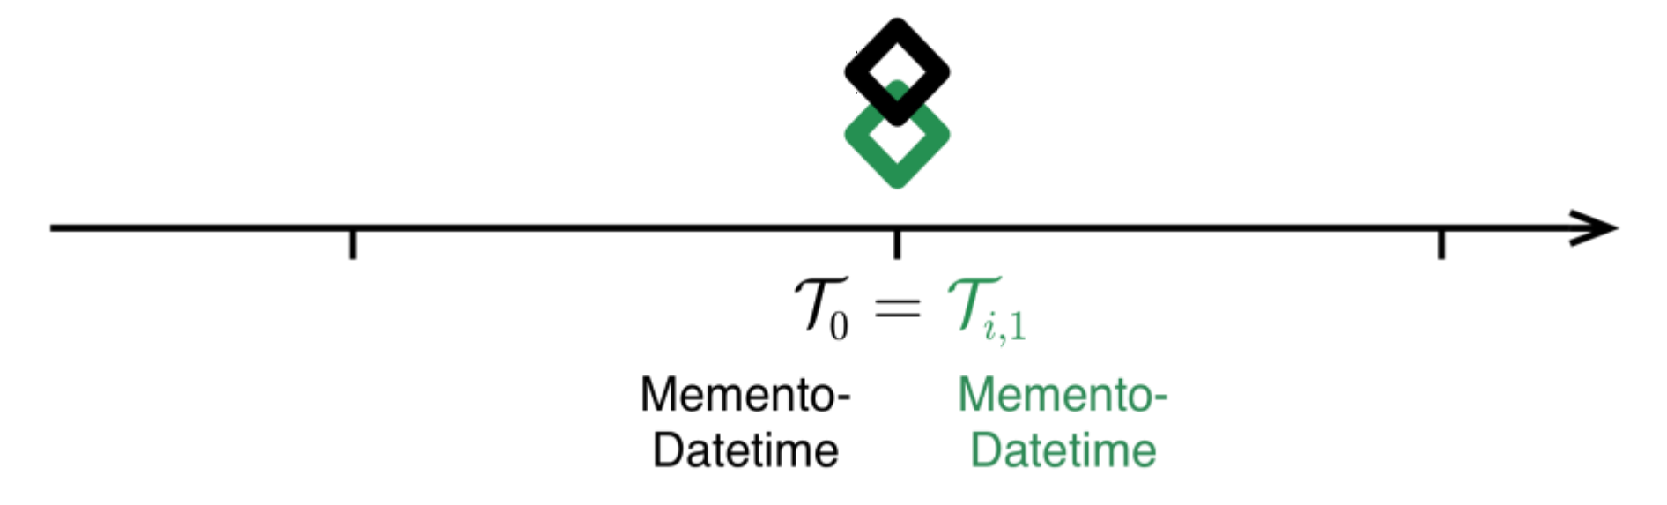
Prima Facie Coherent
An embedded memento existed in its archived state at the time the root memento was captured.
Slide 14,https://www.slideshare.net/ScottAinsworth/only-one-out-of-five-archived-web-pages-existed-as-presented

Slide 15
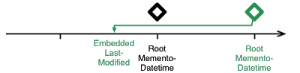

Prima Facie Coherent
Bracket Pattern
https://ws-dl.blogspot.com/2015/12/2015-12-08-evaluating-temporal.html

Slide 16
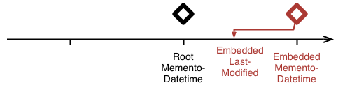
Prima Facie Violative
An embedded memento that did not exist in its archived state at the time the root memento was captured.
https://ws-dl.blogspot.com/2015/12/2015-12-08-evaluating-temporal.html

Slide 17
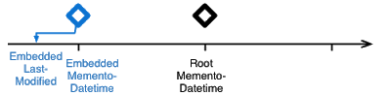
Possibly Coherent
An embedded memento might have been in its archived state at the time the root memento was captured.
https://ws-dl.blogspot.com/2015/12/2015-12-08-evaluating-temporal.html

Slide 18
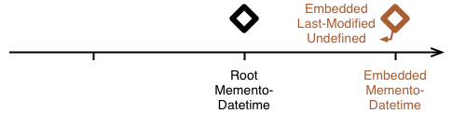
Probably Violative
An embedded memento might not have existed in its archived state at the time the root memento was captured.
https://ws-dl.blogspot.com/2015/12/2015-12-08-evaluating-temporal.html

Slide 19
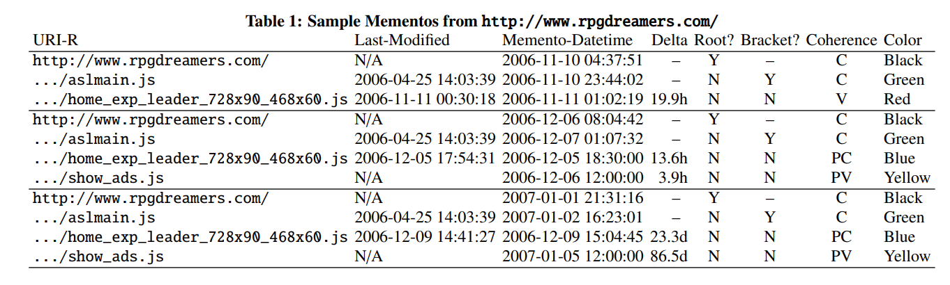
Representing Coherence
https://citeseerx.ist.psu.edu/viewdoc/download?doi=10.1.1.711.77&rep=rep1&type=pdf

Slide 20
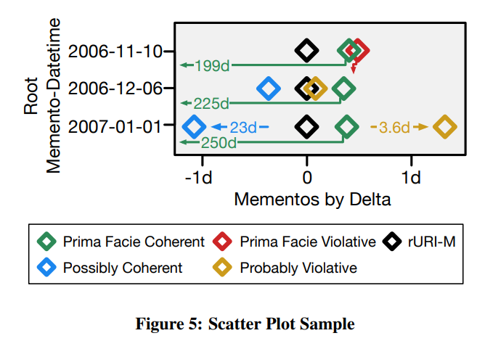
https://citeseerx.ist.psu.edu/viewdoc/download?doi=10.1.1.711.77&rep=rep1&type=pdf

Slide 21
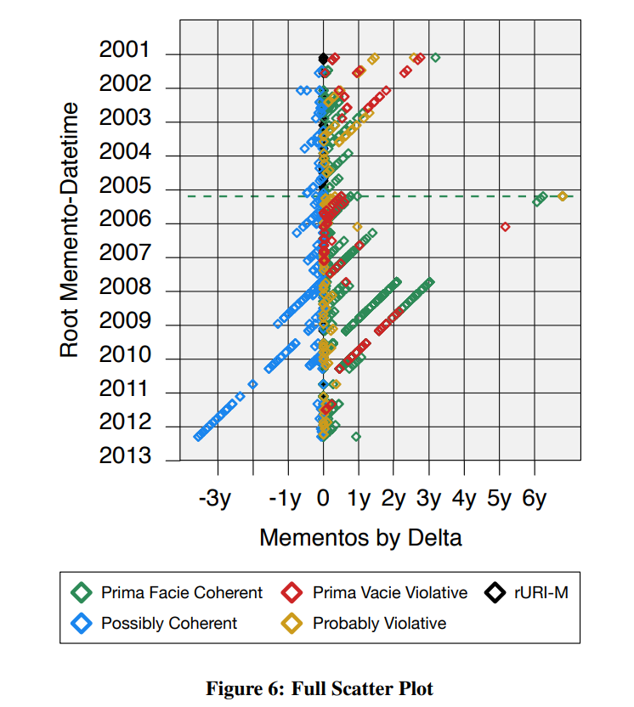
https://citeseerx.ist.psu.edu/viewdoc/download?doi=10.1.1.711.77&rep=rep1&type=pdf

Slide 22
Single and Multiple Archives
Heuristics
Mindst: Selects the nearest capture of embedded URI
Bracket: (Last modified, Memento datetime)

Slide 23
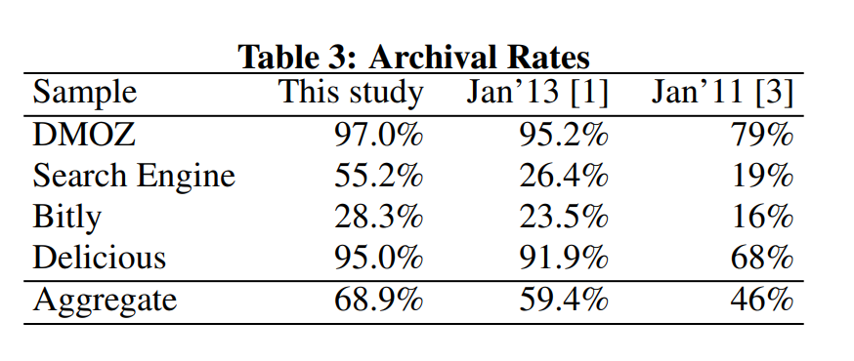
Dataset
https://citeseerx.ist.psu.edu/viewdoc/download?doi=10.1.1.711.77&rep=rep1&type=pdf

Slide 24
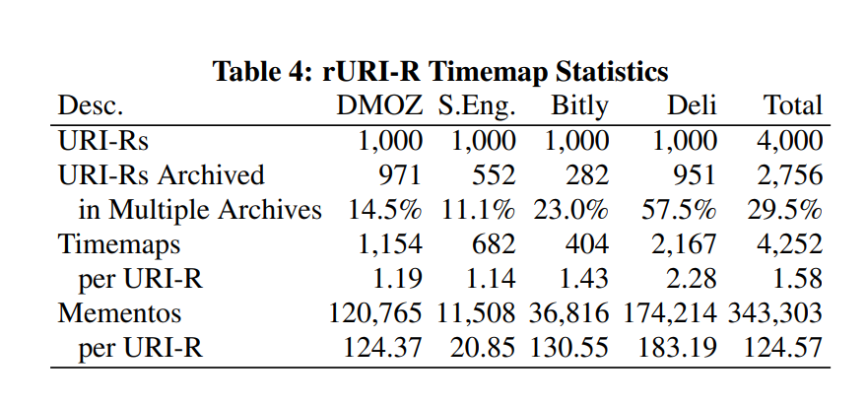
Selection of rURIM’s
Retrieve timemaps for all 4,000 sample rURI-Rs from 15 archives
Retrieve a single root memento per month
https://citeseerx.ist.psu.edu/viewdoc/download?doi=10.1.1.711.77&rep=rep1&type=pdf

Slide 25
Recomposition of composite mementos
Retrieve 88,054 rURIM-M using curl.
Extract eURI-Rs for the root mementos that received 200 response.
Retrieve the eURI-R timemap using curl.
Select eURI-M for eURI-R using heuristics.
Download embedded memento using curl
Steps 2–5 were repeated for other resources.

Slide 26
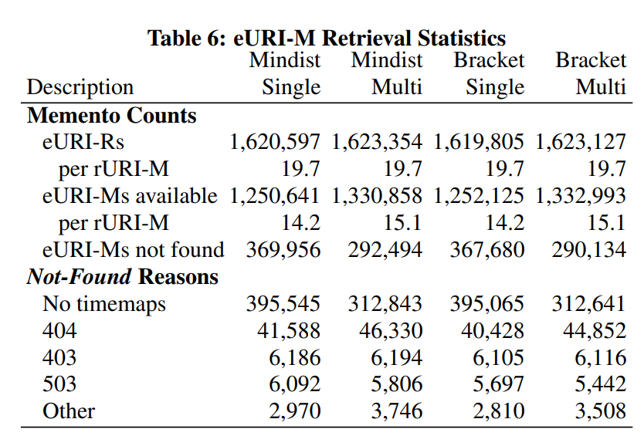
https://citeseerx.ist.psu.edu/viewdoc/download?doi=10.1.1.711.77&rep=rep1&type=pdf

Slide 27
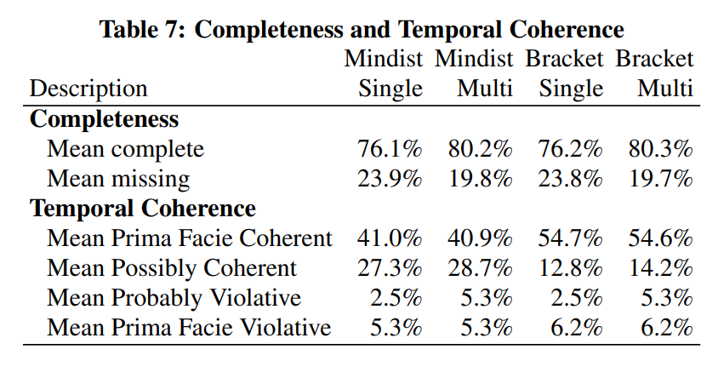
Results
https://citeseerx.ist.psu.edu/viewdoc/download?doi=10.1.1.711.77&rep=rep1&type=pdf

Slide 28
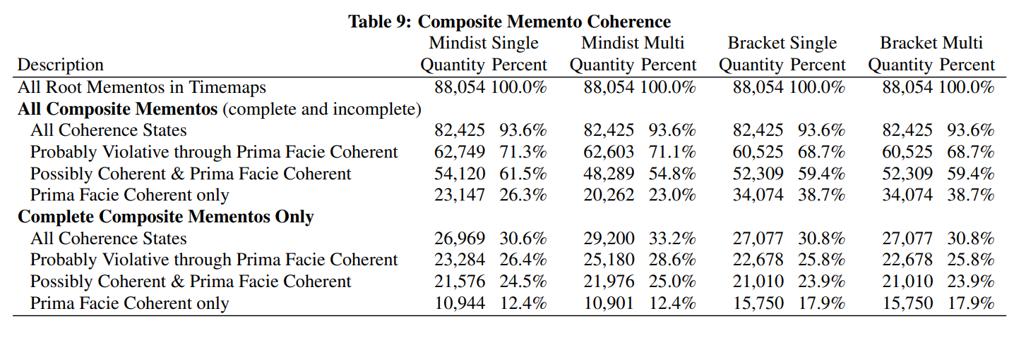
Results
38.7 % of web pages are temporally coherent
17.9% (~1 in 5) temporally coherent mementos can be fully recomposed.
https://citeseerx.ist.psu.edu/viewdoc/download?doi=10.1.1.711.77&rep=rep1&type=pdf

Slide 29
Future Work
Develop a heuristic to locate reasonable substitute in timemap.
Use Lexical signatures and Simhash to find similar resource.
Interface indicating the temporal coherence of the composite mementos.

